Slide 1
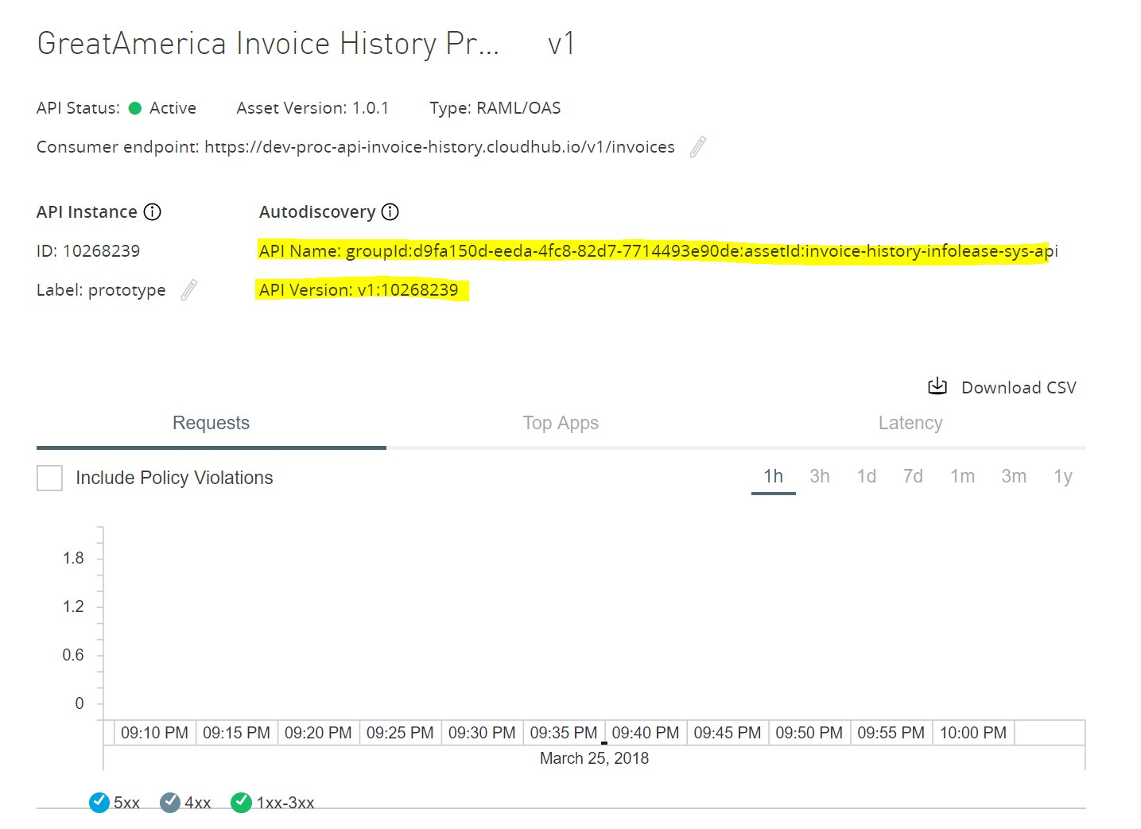

Slide 2
Frameworks enable Functional Use Cases
Functional Use Cases
DVP
CGS
DAS
Frameworks: Exception, Logging, Caching, CM, Testing,
Data Management, API Catalog, Design Patterns,
Sprint Process, Naming Conventions, API Portal, etc.

Slide 3
What is a Framework?
Design
Visible
Re-Usable
Flexible
Scalable
Document
Collaborate
New Requests
Functional Enablement
Change
Impacts
Enforce
Accessible
Samples
KT
Governance
Execution

Slide 4
Playbook
Framework
Pattern
Example
Constraint
Standard
Instruction

Slide 5
env
type
Organization
api
VA Domain
version
application
canonical
https://dev-exp-vet360.va.gov:8081/api/v1/veteranportal/address

Slide 6
Backup (Not currently published)

Slide 7
Constraints, Patterns, Standards, Instructions Examples
Frameworks
Playbook

